Slide 1
Unit 4

Slide 2
Syllabus
Neuro-Fuzzy Systems:
Neuro-fuzzy modeling,
Neuro-fuzzy control.
Genetic Algorithms- Simple GA, crossover and mutation, genetic algorithms in search and optimization.

Slide 3
Introduction to Neuro-Fuzzy Systems

Slide 4
Neuro-Fuzzy Systems
The combination of fuzzy logic and neural network technology is called "Neuro-Fuzzy" and combines the advantages of the two technologies.

Slide 5
Neuro-Fuzzy Systems (contd.)
Neural
Network
+
Fuzzy
Logic
Good for learning.
Human reasoning scheme.
Supervised leaning
Unsupervised learning
Reinforcement learning
Readable Fuzzy rules
Interpretable
Not good for human to interpret its internal representation.
Fuzzy rules and membership functions are subjective.

Slide 6
Neuro-Fuzzy Systems (contd.)
Neural
Network
+
Fuzzy
Logic
A neuro-fuzzy system is a fuzzy system that uses a learning algorithm derived from or inspired by neural network theory to determine its parameters by processing data samples.

Slide 7
Neuro-Fuzzy Systems (contd.)
Neural
Network
+
Fuzzy
Logic
fuzzy sets and fuzzy rules
A neuro-fuzzy system is a fuzzy system that uses a learning algorithm derived from or inspired by neural network theory to determine its parameters by processing data samples.

Slide 8
Combining Neural and Fuzzy
The key benefit of fuzzy logic is, that it lets you describe desired system behavior with simple "if-then" relations. In many applications, this gets you a simpler solution in less design time.
In addition, you can use all available engineering know-how to optimize the performance directly. While this is certainly the beauty of fuzzy logic, it at the same time is its major limitation.
In many applications, knowledge that describes desired system behavior is contained in data sets. Here, the designer has to derive the "if-then" rules from the data sets manually, which requires a major effort with large data sets.
When data sets contain knowledge about the system to be designed, a neural net promises a solution as it can train itself from the data sets.
However, only few commercial applications of neural nets exist. This is a contrast to fuzzy logic, which is a very common design technique in Asia and Europe.

Slide 9
Sparse use of neural nets in applications
The sparse use of neural nets in applications is due to a number of reasons.
First, neural net solutions remain a "black box". You can neither interpret what causes a certain behavior nor can you modify a neural net manually to change a certain behavior.
Second, neural nets require prohibitive (too expensive) computational effort for most mass-market products.
Third, selection of the appropriate net model and setting the parameters of the learning algorithm is still a "black art" and requires long experience.
Of the aforementioned reasons, the lack of an easy way to verify and optimize a neural net solution is probably the major limitation.

Slide 10
Combining Neural and Fuzzy
In simple words, both neural nets and fuzzy logic are powerful design techniques that have its strengths and weaknesses.
Neural nets can learn from data sets while fuzzy logic solutions are easy to verify and optimize.
If you look at these properties in a portfolio, the idea becomes obvious, that a clever combination of the two technologies delivers best of both worlds.
Combine the explicit knowledge representation of fuzzy logic with the learning power of neural nets, and you get NeuroFuzzy.

Slide 11
Training Fuzzy Logic Systems with NeuroFuzzy
Many alternative ways of integrating neural nets and fuzzy logic have been proposed in the scientific literature.
The first artificial neural net implementation dates over 50 years back.
Since then, most research dealt with learning techniques and algorithms.
One major milestone in the development of neural net technology was the invention of the so-called error back propagation algorithm about ten years ago.

Slide 12
Neuro-Fuzzy systems
There are a number of ways fuzzy logic can be used with neural networks.
Perhaps the simplest way to use a fuzzifier function to preprocess or post process data for a neural network.
In the figure, neural network has a preprocessing fuzzifier that converts data into fuzzy data for application to a neural network.

Slide 13
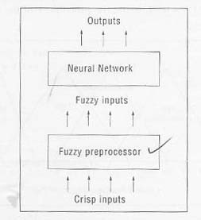
A neural network with fuzzy preprocessor

Slide 14
Neuro-fuzzy approach
Presently, the neuro-fuzzy approach is becoming one of the major areas of interest because it gets the benefits of neural networks as well as of fuzzy logic systems and it removes the individual disadvantages by combining them on the common features.
Different architectures of neuro-fuzzy system have been investigated by number of researchers such as Lin (1994), Medsker (1995) and Jana (1996).
These architectures have been applied in many applications especially in the process control.

Slide 15
Neuro-fuzzy approach
Ever since fuzzy systems were applied in industrial applications, developers know that the construction of a well performing fuzzy system is not always easy.
The problem of finding appropriate membership functions and fuzzy rules in often a tiring process of trial and error.
Therefore the idea of applying learning algorithms to fuzzy was considered early approaches to so call adaptive or self organizing fuzzy controllers can be found in literature.
These kind of adaptive models usually use knowledge based methods. However, another possibility of learning parameters of fuzzy systems is given by neural networks.
The learning capabilities of neural networks made them a prime target for a combination with fuzzy systems in order to automate or support the process of developing a fuzzy system for a given task.
The neuro-fuzzy approaches were considered mainly in the domain of neuro-fuzzy control, but today the approach is more general. Neuro-fuzzy systems are applied in various domains, e.g., control, data analysis, decision support, etc.

Slide 16
Modern neuro-fuzzy systems
Modern neuro-fuzzy systems are usually represented as a multilayer feed forward neural network, but fuzzification of other neural network architectures are also considered, for example self-organizing feature maps.
In neuro-fuzzy models, connection weights, a propagation and activation function comes from common neural networks.

Slide 17
Learning by Error Back Propagation
The error back propagation algorithm soon became the standard for most neural net implementation due to its high performance.
First, it selects one of the examples of the training data set.
Second, it computes the neural net output values for the current training examples' inputs.
Then, it compares these output values to the desired output value of the training example.
The difference, called error, determines which neuron in the net shall be modified and how.
The mathematical mapping of the error back into the neurons of the net is called error back propagation.

Slide 18
Learning by Error Back Propagation
If the error back propagation algorithm is so powerful, why not use it to train fuzzy logic systems too?
Alas, this is not straightforward.
To determine which neuron has what influence, the error back propagation algorithm differentiates the transfer functions of the neurons.
One problem here is that the standard fuzzy logic inference cannot be differentiated.

Slide 19
Learning by Error Back Propagation
To solve these problems, some neuro-fuzzy development tools use extended fuzzy logic inference methods.
The most common approach is to use so-called Fuzzy Associative Memories (FAMs).
A FAM is a fuzzy logic rule with an associated weight. A mathematical framework exists that maps FAMs to neurons in a neural net.
This enables the use of a modified error back propagation algorithm with fuzzy logic.
As a user of NeuroFuzzy tools, you do not need to worry about the details of the algorithm.
Today's NeuroFuzzy tools work as an "intelligent" assistant with your design.
They help you to generate and optimize membership functions and rule bases from sample data.

Slide 20
Different approaches
Although there are a lot of different approaches, we want to restrict them term neuro-fuzzy to systems which display the following properties:
1. A neuro-fuzzy system is a fuzzy system that is trained by a learning algorithm usually derived from neural network theory. The (heuristic) learning procedure operates on local information, and causes only local modifications in the underlying fuzzy system. The learning process is not knowledge based, but data driven.

Slide 21
Different approaches
2. A neuro-fuzzy system can be viewed as a special 3-layer feed forward neural network.
The first layer represents input variables, the middle (hidden) layer represents fuzzy rules and the third layer represents output variables.
Fuzzy sets are encoded as (fuzzy) connection weights. Some neuro-fuzzy models use more than 3 layers, and encode fuzzy sets as activation functions.
In this case, it is usually possible to transform them into 3 layer architecture.
This view of fuzzy systems illustrates the data flow within the system and its parallel nature.

Slide 22
Different approaches
3. A neuro-fuzzy system can always (i.e., during and after learning) be interpreted as a system of fuzzy rules.
4. The learning procedure of neuro-fuzzy systems takes the similar properties of the underlying fuzzy system in to account. This results in constraints on the possible modifications of the system’s parameters.

Slide 23
Different approaches
5. A neuro-fuzzy system approximates an n-dimensional (unknown) function that is partially given by the training data. The fuzzy rules encoded within the system represent vague samples, and can be viewed as vague prototypes of the training data. A neuro-fuzzy system should not be seen as a kind of (fuzzy) expert system, and it has nothing to do with fuzzy logic in the narrow sense.

Slide 24
Definition
Based on the above point, we consider neuro-fuzzy as a technique to derive a fuzzy system from data, or to enhance it by learning from examples.
The exact implementation of the neuro-fuzzy model does not matter.
It is possible to use a neural network to learn certain parameters of a fuzzy system, like using a self-organizing feature map to find fuzzy rules(cooperative models), or to view a fuzzy system as a special neural network and to apply a learning algorithm directly (hybrid models).

Slide 25
Models of neuro-fuzzy systems
Two possible models of neuro-fuzzy systems are:
In response to linguistic statements, the fuzzy interface block provides an input vector to a multi-layer neural network. The neural network can be adapted (trained) to yield desired command outputs or decisions as shown in fig. below.

Slide 26
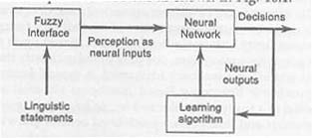
The first model of neuro-fuzzy system

Slide 27
Models of neuro-fuzzy systems
2. A multi-layered neural network drives the fuzzy inference mechanism (Fig.below).
Neural networks are used to tune membership functions of fuzzy systems that are employed as decision –making systems for controlling equipment.
Although fuzzy logic can encode expert knowledge directly using rules with linguistic labels, it usually takes a lot of time to design and tune the membership functions which quantitatively define these linguistic labels.
Neural network learning techniques can automate this process and substantially reduce development time and cost while improving performance.

Slide 28
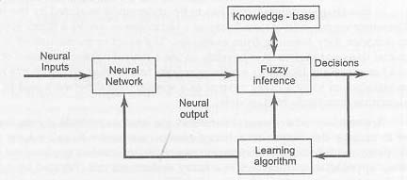
The second model of neuro-fuzzy system

Slide 29
Conclusion
In theory, neural networks, and fuzzy systems are equivalent in that they are convertible, yet in practice each has its own advantages and disadvantages.
For neural networks, the knowledge is automatically acquired by the back-propagation algorithm, but the learning process is relatively slow and analysis of the trained network is difficult.
Neither is it possible to extract structural knowledge from the trained neural network, nor can we integrate special information about the problem into the neural network in order to simplify the learning procedure.

Slide 30
Conclusion (contd.)
Fuzzy systems are more favorable in that their behavior can be explained based on fuzzy rules and thus their performance can be adjusted by tuning the rules.
But since, in general, knowledge acquisition is difficult and also the universe of discourse of each input variable needs to be divided in to several intervals, applications of fuzzy systems are restricted to the fields where expert knowledge is available and the number of input variable is small.

Slide 31
Genetic algorithm

Slide 32
Genetics
Genetics is a science which deals with the transfer of biological information from generation to generation.
Genetics deals with the physical and chemical nature of these information's itself.
Geneticists are concerned with whys and how’s of these transfer of biological information, which is the basis for certain differences and similarities that are recognized in a group of living organisms.
What is the source of genetic variations?
How are difference distributed in populations?
Why not all variations among living things however are inherited?
All these are concern with genetics.

Slide 33
Genetics
The mechanism of genetics is entirely based on gene.
The gene concept however, had been implicit in model’s visualization of a physical element or factor that acts as the foundation of development of a trait.
He first postulated the existence of genes from their end effects, as expressed in altered characteristics.
The word “allelmorph”, shortened to “allele” is used to identify the member of paired genes that control different alternative traits.
The gene is characterized as an individual unit of genetic mechanism. Genes replicate themselves and reproduce chromosomes, cells and organisms of their own kind.
Gene is the part of chromosome. Some chromosomal genes work together, each making a small contribution to height, weight or intelligence, etc.
Genes not only have a basic role in the origin and life of individual organisms, but they also, through variation in gene frequencies, cause change in populations.

Slide 34
What is GA
A genetic algorithm (or GA) is a search technique used in computing to find true or approximate solutions to optimization and search problems.
Genetic algorithms are categorized as global search heuristics.
Genetic algorithms are a particular class of evolutionary algorithms that use techniques inspired by evolutionary biology such as inheritance, mutation, selection, and crossover (also called recombination).

Slide 35
What is GA
The evolution usually starts from a population of randomly generated individuals and happens in generations.
In each generation, the fitness of every individual in the population is evaluated, multiple individuals are selected from the current population (based on their fitness), and modified (recombined and possibly mutated) to form a new population.

Slide 36
What is GA
The new population is then used in the next iteration of the algorithm.
Commonly, the algorithm terminates when either a maximum number of generations has been produced, or a satisfactory fitness level has been reached for the population.
If the algorithm has terminated due to a maximum number of generations, a satisfactory solution may or may not have been reached.

Slide 37
Evolution
Here’s a very oversimplified description of how evolution works in biology
Organisms (animals or plants) produce a number of offspring which are almost, but not entirely, like themselves
Variation may be due to mutation (random changes)
Variation may be due to sexual reproduction (offspring have some characteristics from each parent)
Some of these offspring may survive to produce offspring of their own—some won’t
The “better adapted” offspring are more likely to survive
Over time, later generations become better and better adapted
Genetic algorithms use this same process to “evolve” better programs

Slide 38
Genetic Algorithms
Proposed by John Holland (1975)
A Genetic Algorithm (GA) is a search technique used in computing to find exact or approximate solutions to optimization and search problems.
GA uses techniques inspired by evolutionary biology such as inheritance, mutation, selection, and crossover.

Slide 39
Genetic Algorithms
Genetic algorithms are computerized search and optimization algorithms based on the mechanics of natural genetics and natural selection
Derived by biologists
The offspring have certain desirable characteristics
Mathematical terminology | Equivalent biological terminology
Parameter | Gene
Set of parameters | Chromosome
Objective function evaluation | Fitness value
Population of individuals | Set of solutions

Slide 40
Genetic Algorithms
The beginnings of genetic algorithms can be traced back to the early 1950s when several biologists used computers for simulations of biological systems (Goldberg and Holland 1989).
However, the work done in late 1960s and early 1970s at the University of Michigan under the guidance of John Holland led to genetic algorithms as they are known today.
GA vocabulary is being borrowed from natural genetics.
The idea behind genetic algorithms is to do what nature does.
Genetic algorithms (GAs) are stochastic algorithms whose search methods inspired from phenomena found in living nature.

Slide 41
Genetic Algorithms
The phenomena incorporated so far in GA models include phenomena of natural selection as there are selection and the production of variation by means of recombination and mutation, and rarely inversion, diploid and others.
Most Genetic algorithms work with one large panmictic population, i.e. in the recombination step each individual may potentially choose any other individual from the population as a mate.

Slide 42
GA operators
Then GA operators are performed to obtain the new child offspring; the operators are:
Encoding
Selection
Crossover,
Mutation,
Survival of fittest

Slide 43
Encoding
The process of representing the solution in the form of a string that conveys the necessary information.
Just as in a chromosome, each gene controls a particular characteristic of the individual, similarly, each bit in the string represents a characteristic of the solution.
Notes:
The very first step in Gas, is coming up with a random population of solutions. Each of these solutions is represented in the form of a string and this process is called encoding.
Just as we have chromosomes in animals that are made up of a string of genes, similarly the solutions in Gas are represnted in the form of strings, which are made up of characters, each of which stand for and control a particular aspect of the solution.
There are many methods of encoding, the common ones are binary encoding, real encoding ,etc. The method chosen depends on the problem at hand.

Slide 44
Encoding Methods
Binary Encoding – Most common method of encoding. Chromosomes are strings of 1s and 0s and each position in the chromosome represents a particular characteristic of the problem.
Chromosome A
10110010110011100101
Chromosome B
11111110000000011111

Slide 45
Encoding Methods (contd.)
Permutation Encoding – Useful in ordering problems such as the Traveling Salesman Problem (TSP). Example. In TSP, every chromosome is a string of numbers, each of which represents a city to be visited.
Chromosome A
1 5 3 2 6 4 7 9 8
Chromosome B
8 5 6 7 2 3 1 4 9

Slide 46
Encoding Methods (contd.)
Value Encoding – Used in problems where complicated values, such as real numbers, are used and where binary encoding would not suffice.
Good for some problems, but often necessary to develop some specific crossover and mutation techniques for these chromosomes.
Chromosome A
1.235 5.323 0.454 2.321 2.454
Chromosome B
(left), (back), (left), (right), (forward)

Slide 47
Selection
As in natural surroundings it holds on average: “the better the parents, the better the offsprings” and “the offspring is similar to the parents”.
Therefore, it is on the one hand desirable to choose the fittest individuals more often, but on the other hand not too often, because otherwise the diversity of the search space decreases.
GA researchers have developed a variety of selection algorithms to make it more efficient and robust.

Slide 48
Selection algorithm
Roulette Wheel Selection
Tournament Selection
Linear Rank Selection

Slide 49
Roulette Wheel Selection
In roulette selection chromosomes are selected based on their fitness relative to all other chromosomes in the population.
One disadvantage of using roulette wheel is that its selective pressure reduces as population converges upon a solution, which reduces the convergence rate and may not allow finding the better solutions.

Slide 50
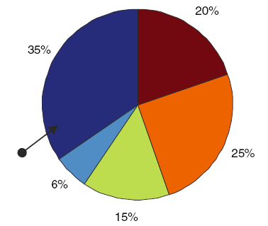
Roulette Wheel Selection

Slide 51
Tournament Selection
In this process of selection, one parent is selected by randomly comparing other individual in the same population and select with the best fitness.
To select the second parent the same process is repeated.
It is most popular selection method due to its simplicity.

Slide 52
Linear Rank Selection
In this method the individuals are ordered according to their fitness values.
The individuals of highest fitness are kept on the top and worst on the bottom.
Then each individual in the population is assigned a subjective fitness based on linear ranking function as
f(r)=(popsize-rank)(max-min)/(Popsize-1)+min
where popsize – population size
rank – rank in the current population
max, min – maximum and minimum subjective fitness determined by the user.
Now this subjective fitness value is assigned to the individual and the selection is done on the basis of roulette wheel spinning.
In this selection process the selective pressure is constant and does not change with generation to generation.
However, in this process, it is necessary to sort the population according to their fitness values and the individuals of same fitness will not have the same probability of being selected.

Slide 53
Crossover
Obviously, selection alone can not generate better offsprings.
To produce better new off springs a crossover operator is required. A crossover operator can be termed loosely as recombination or slice-exchange-merge operator.
The most common type of crossover operator mentioned above is called single point crossover.
In this operation select two parents and randomly selects a point between two genes to cut both chromosomes into two parts.
This point is called crossover point.
In crossover operation combine the first part of first parent and second part of second parent to get first offspring.
Similarly, combine the first part of second parent and second part of first parent to get second offspring.
These offsprings belong to the next population.

Slide 54
Crossover
The crossover operator has three distinct sub steps:
Slice each of the parent strings in two substrings.
Exchange a pair of corresponding substrings of parents.
Merge the two respective substrings to form offsprings.

Slide 55
Example
For example, suppose following two binary strings are mated together and undergoes the crossover operation.
The strings are 1100000, 0101111.
By a random choice the crossover site is fixed at 3 which is shown by a vertical bar.
Then the effect of cross over will be as shown in below figure.

Slide 56
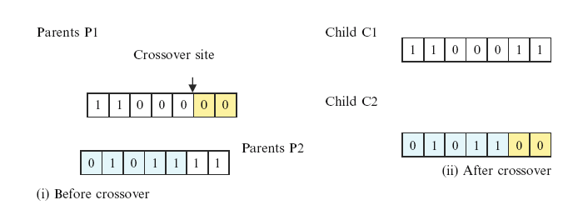
Single point cross over operation with two strings

Slide 57
Example
To increase the speed of convergence of GA, the population is divided from the middle and two halves (subgroups) are used in group cross over as shown in Fig. below.

Slide 58
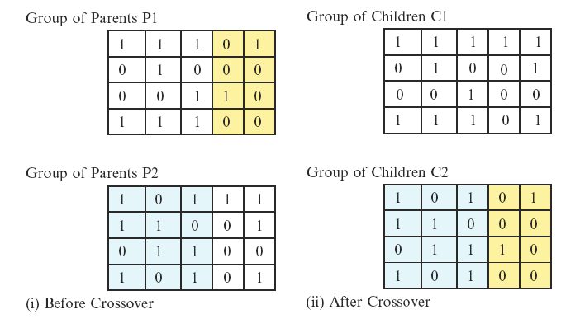
Single point Group Cross over operation

Slide 59
Example
Another type of crossover is multi-point cross over, in which two or more than two sites have been selected and exchange have been done as illustrated in Fig. below.

Slide 60
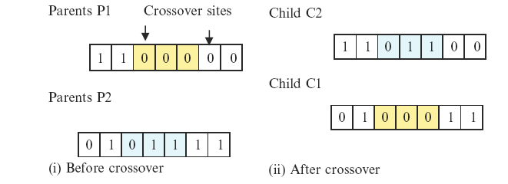
Multipoint crossover

Slide 61
Mutation
The newly created individuals have no new inheritance information and the number of alleles is constantly decreasing.
This process results in the contraction of the population to one point, which is only wished at the end of the convergence process, after the population works in a very promising part of the search space.
Diversity is necessary to search a big part of the search space.
It is one goal of the learning algorithm to search always in regions not viewed before.
Therefore, it is necessary to enlarge the information contained in the population.

Slide 62
Mutation
One way to achieve this goal is mutation.
The mutation operator M (chromosome) selects a gene of that chromosome and changes the allele by an amount called the mutation variance (mv), this happens with a mutation frequency (mf).
The parameter mutation variance and mutation frequency have a major influence on the quality of learning algorithms.
For binary coded GAs mutation is equivalent of flipping a bit at any particular position.
Since, mutation is to be used sparingly its probability is very low.
The mutation operation may be shown as in Fig.below. The group mutation and multipoint mutation may also be performed to improve the results.

Slide 63
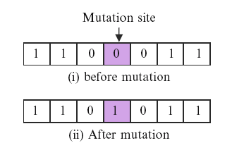
Single point mutation operation

Slide 64
Survival of Fittest
Further more we only accept an offspring as a new member of population, if it differ enough from the other individuals, that means here its fitness differ from all other individuals at least by some significant amount.
After accepting a new individual we remove one of the worst individual (i.e. its fitness value is quite low) from the population in order to hold the population size constant.

Slide 65
Advantages Of GAs
Global Search Methods: GAs search for the function optimum starting from a population of points of the function domain, not a single one. This characteristic suggests that GAs are global search methods. They can, in fact, climb many peaks in parallel, reducing the probability of finding local minima, which is one of the drawbacks of traditional optimization methods.

Slide 66
Advantages of GAs (contd.)
Blind Search Methods: GAs only use the information about the objective function. They do not require knowledge of the first derivative or any other auxiliary information, allowing a number of problems to be solved without the need to formulate restrictive assumptions. For this reason, GAs are often called blind search methods.

Slide 67
Advantages of GAs (contd.)
GAs use probabilistic transition rules during iterations, unlike the traditional methods that use fixed transition rules.
This makes them more robust and applicable to a large range of problems.

Slide 68
Advantages of GAs (contd.)
GAs can be easily used in parallel machines- Since in real-world design optimization problems, most computational time is spent in evaluating a solution, with multiple processors all solutions in a population can be evaluated in a distributed manner. This reduces the overall computational time substantially.

Slide 69
Main Components of GA
A GA for a particular problem must have the following five components:
A genetic representation for potential solutions to the problem (Coding).
A way to create an initial population of potential solution.
To evaluate rank of a solution define an objective function.
To alter the composition of offspring’s define genetic operators.
Define GA parameters like population size, probabilities of genetic operators, etc.

Slide 70
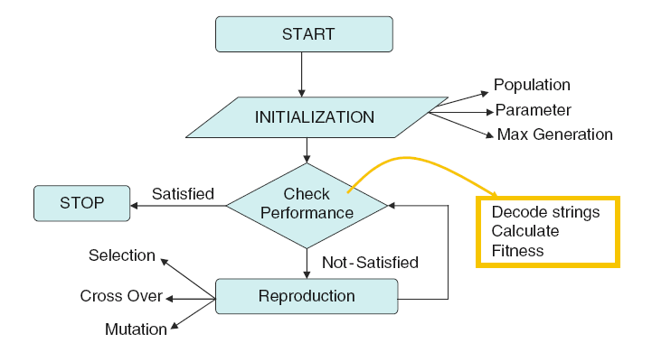
Flow chart of simple genetic algorithm

Slide 71
Working Mechanism Of GAs
Begin
Initialize population
Evaluate Solutions
T =0
Optimum Solution?
N
Selection
Y
T=T+1
Stop
Crossover
Mutation
Notes:
GAs implement optimization techniques by simulating this natural law of evolution in the biological world.
We start with a population of randomly generated solutions. Each of these solutions is evaluated to determine how good or bad it is.In other words to determine how “fit” that solution is. We then check a terminating condition, to see if our solutions are good enough? If yes, we stop. If not, we have to optimize the solutions.
So, we select the best solutions from the initial population (selection). This is similar to “natural selection”.
Then we allow these good solutions to exchange their information, in order to get even better solutions. This step is similar to reproduction among animals or crossover among chrmosomes and is called “cross-over”. We may then randomly mutate some small % of the solutions thus obtained after crossover.
Mutation is very imp. It could be a bad thing, it could be a good thing. In the boliogical sense it mean, making a small change in a gene. In GAs, it means, making a small change to the solution.
Then again, we evaluate each of the sokutions, and check the termination condition. As you see , this is an optmization method.

Slide 72
Applications of Genetic Algorithms
GA is not only used for solving optimization problems, but there are number of GA applications as mentioned below:
Industrial design by parameterization
Scheduling problems such as manufacturing, facility scheduling, allocation of resources, etc.
System design
Time series prediction
Data base mining
Control system
Artificial life system
Various medical applications, such as image segmentation and modeling
Combinatorial optimization problems like travelling sales man problem, routing, bin packing, graph partitioning and colouring.
Trajectory planning of robots
Game playing like chase playing, prisoner’s dilemma, etc.
Resource allocation problem
Graph colouring and partitioning, etc.

Slide 73
Genetic Algorithms To Solve The Traveling Salesman Problem (TSP)

Slide 74
The Problem
The Traveling Salesman Problem is defined as:
‘We are given a set of cities and a symmetric distance matrix that indicates the cost of travel from each city to every other city.
The goal is to find the shortest circular tour, visiting every city exactly once, so as to minimize the total travel cost, which includes the cost of traveling from the last city back to the first city’.

Slide 75
Encoding
I represent every city with an integer .
Consider 6 Indian cities –
Mumbai, Nagpur , Calcutta, Delhi , Bangalore and Chennai and assign a number to each.
Mumbai 1
Nagpur 2
Calcutta 3
Delhi 4
Bangalore 5
Chennai 6

Slide 76
Encoding (contd.)
Thus a path would be represented as a sequence of integers from 1 to 6.
The path [1 2 3 4 5 6 ] represents a path from Mumbai to Nagpur, Nagpur to Calcutta, Calcutta to Delhi, Delhi to Bangalore, Bangalore to Chennai, and finally from Chennai to Mumbai.
This is an example of Permutation Encoding as the position of the elements determines the fitness of the solution.

Slide 77
Fitness Function
The fitness function will be the total cost of the tour represented by each chromosome.
This can be calculated as the sum of the distances traversed in each travel segment.
The Lesser The Sum, The Fitter The Solution Represented By That Chromosome.

Slide 78
Distance/Cost Matrix For TSP
 | 1 | 2 | 3 | 4 | 5 | 6
1 | 0 | 863 | 1987 | 1407 | 998 | 1369
2 | 863 | 0 | 1124 | 1012 | 1049 | 1083
3 | 1987 | 1124 | 0 | 1461 | 1881 | 1676
4 | 1407 | 1012 | 1461 | 0 | 2061 | 2095
5 | 998 | 1049 | 1881 | 2061 | 0 | 331
6 | 1369 | 1083 | 1676 | 2095 | 331 | 0
Cost matrix for six city example.
Distances in Kilometers

Slide 79
Fitness Function (contd.)
So, for a chromosome [4 1 3 2 5 6], the total cost of travel or fitness will be calculated as shown below
Fitness = 1407 + 1987 + 1124 + 1049 + 331+ 2095
= 7993 kms.
Since our objective is to Minimize the distance, the lesser the total distance, the fitter the solution.

Slide 80
Selection Operator
I used Tournament Selection.
As the name suggests tournaments are played between two solutions and the better solution is chosen and placed in the mating pool.
Two other solutions are picked again and another slot in the mating pool is filled up with the better solution.

Slide 81
Tournament Selection (contd.)

Slide 82
Why we cannot use single-point crossover:
Single point crossover method randomly selects a crossover point in the string and swaps the substrings.
This may produce some invalid offsprings as shown below.
4 | 1 | 3 | 2 | 5 | 6
4 | 1 | 3 | 1 | 5 | 6
4 | 3 | 2 | 1 | 5 | 6
4 | 3 | 2 | 2 | 5 | 6

Slide 83
Crossover Operator
I used the Enhanced Edge Recombination operator (T.Starkweather, et al, 'A Comparison of Genetic Sequencing Operators, International Conference of GAs, 1991 ) .
This operator is different from other genetic sequencing operators in that it emphasizes adjacency information instead of the order or position of items in the sequence.
The algorithm for the Edge-Recombination Operator involves constructing an Edge Table first.

Slide 84
Edge Table
The Edge Table is an adjacency table that lists links into and out of a city found in the two parent sequences.
If an item is already in the edge table and we are trying to insert it again, that element of a sequence must be a common edge and is represented by inverting it's sign.

Slide 85
Finding The Edge Table
1
4
3
2
5
2
-3
5
1
3
1
-2
4
4
-6
1
3
5
1
2
-6
6
-5
-4

Slide 86
Enhanced Edge Recombination Algorithm
Choose the initial city from one of the two parent tours. (It can be chosen randomly as according to criteria outlined in step 4). This is the current city.
Remove all occurrences of the current city from the left hand side of the edge table.( These can be found by referring to the edge-list for the current city).
If the current city has entries in it's edge-list, go to step 4 otherwise go to step 5.
Determine which of the cities in the edge-list of the current city has the fewest entries in it's own edge-list. The city with fewest entries becomes the current city. In case a negative integer is present, it is given preference. Ties are broken randomly. Go to step 2.
If there are no remaining unvisited cities, then stop. Otherwise, randomly choose an unvisited city and go to step 2.

Slide 87
Example Of Enhanced Edge Recombination Operator
Step 1
Step 2
1
4
3
2
5
1
3
2
5
2
-3
5
1
2
-3
5
1
3
1
-2
4
3
1
-2
4
-6
1
3
4
-6
1
3
5
3
2
-6
5
3
2
-6
6
-5
-4
6
-5
4
4 6
1 | 2
2
3 | -2
4
5 | 2
6
4 6 5 1 3
4 6 5 1 3 2

Slide 88
Example Of Enhanced Edge Recombination Operator (contd.)
Step 3
Step 4
1
3
2
5
1
3
2
2
-3
5
1
2
-3
1
3
1
-2
3
1
-2
4
1
3
4
1
3
5
3
2
5
3
2
6
-5
6
4 6 5
4 6 5 1

Slide 89
Example Of Enhanced Edge Recombination Operator (contd.)
Step 5
Step 6
1
3
2
1
2
2
-3
2
3
-2
3
-2
4
3
4
5
3
2
5
2
6
6
4 6 5 1 3
4 6 5 1 3 2

Slide 90
Mutation Operator
The mutation operator induces a change in the solution, so as to maintain diversity in the population and prevent Premature Convergence.
In our project, we mutate the string by randomly selecting any two cities and interchanging their positions in the solution, thus giving rise to a new tour.
4
1
3
2
5
6
4
5
3
2
1
6

Slide 91
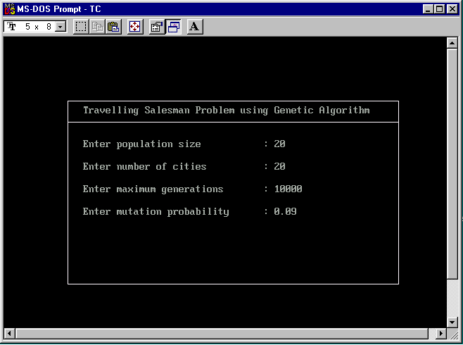
Input To Program

Slide 92
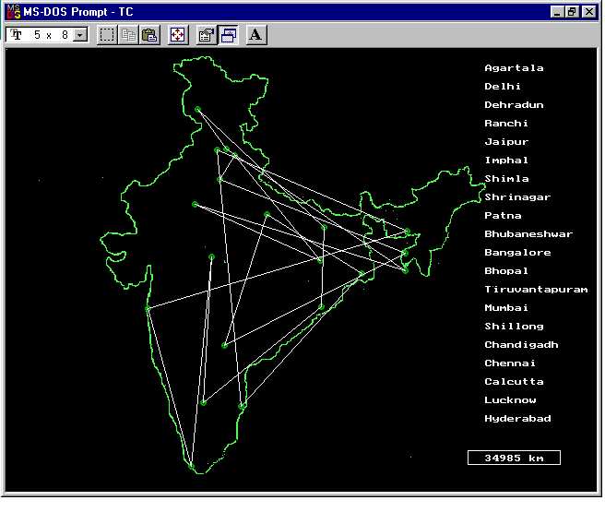
Initial Output For 20 cities : Distance=34985 km
Initial Population

Slide 93
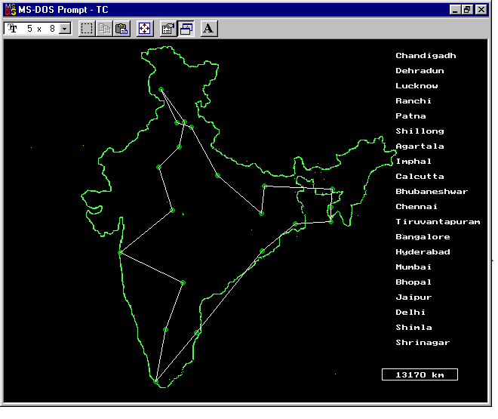
Final Output For 20 cities : Distance=13170 km
Generation 4786

Slide 94
Fuzzy-genetic algorithm

Slide 95
Fusion with Genetic Algorithms
Identifying fuzzy systems with genetic algorithms
Controlling parameters of genetic algorithms with fuzzy systems

Slide 96
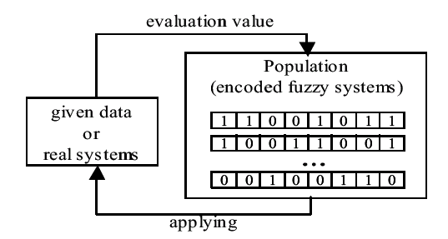
Identifying fuzzy systems with genetic algorithms
Schematic diagram of identifying FSs with GAs

Slide 97
Identifying fuzzy systems with genetic algorithms
Tuning an existing fuzzy system
Building a fuzzy system with genetic algorithm

Slide 98
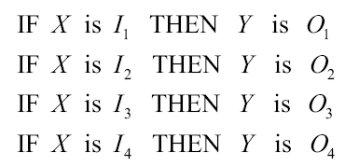



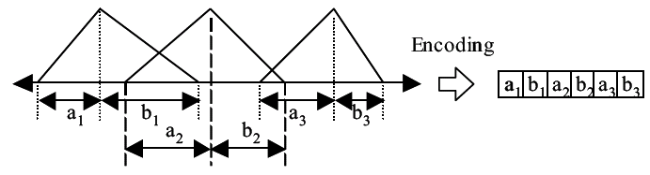
Tuning an existing fuzzy system
Four fuzzy rules:

Slide 99
Building a fuzzy system with genetic algorithm
This method do not need an existing fuzzy system. This approach determines all the parameters of a fuzzy system by genetic algorithms without any priori knowledge.
Thus, the chromosomes used in this method usually include most of the parameters such as the number and membership functions of linguistic terms.
So, it is very important how to effectively represent those parameters because a long chromosome means a wide search space.

Slide 100
Building a fuzzy system with genetic algorithm
If a search space is wide, we cannot expect a good optimization result.
So, most researches make restrictions; for example, some fix the number of linguistic terms or restrict the shape and position of membership functions.

Slide 101

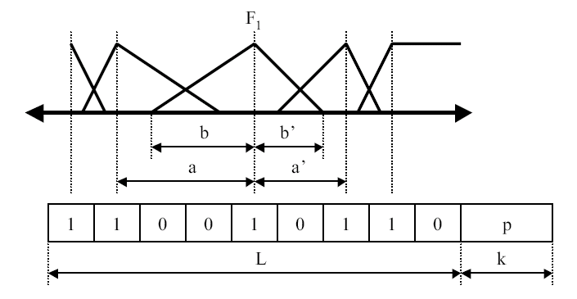
Building a fuzzy system with genetic algorithm

Slide 102
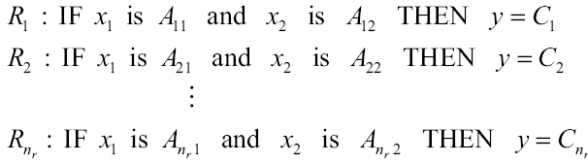
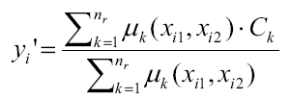
Building a fuzzy system with genetic algorithm
Determination of consequent parts

Slide 103


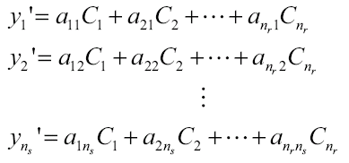
Building a fuzzy system with genetic algorithm

Slide 104
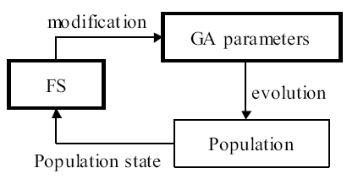

Controlling parameters of genetic algorithms with fuzzy systems

Slide 105
Fuzzy logic application in Medicine

Slide 106
Introduction
Medicine is one field in which the applicability of fuzzy set theory was recognized quite early, in the mid-1970s.
Within this field, it is the uncertainty found in the process of diagnosis of disease that has most frequently been the focus of applications of fuzzy set theory.

Slide 107
Introduction (cond…)
With the increased volume of information available to physicians from new medical technologies, the process of classifying different sets of symptoms under a single name and determining appropriate therapeutic action becomes increasingly difficult.
A single disease may manifest itself quite differently in different patients and at different disease stages.
Furthermore, a single symptom may be indicative of several different diseases, and the presence of several diseases in a single patient may disrupt the expected symptom pattern of any one them.

Slide 108
Introduction (cond…)
The best and most useful descriptions of disease entities often use linguistic terms that are irreducibly vague. For example, hepatitis is characterized by the statement:
“Total proteins are usually normal, albumin is decreased, α-globulins are slightly decreased, β-globulins are slightly decreased, and γ-globulins are increased”,
Where the linguistic terms printed in italics are inherently vague.
Although medical knowledge concerning the symptom- disease relationship constitutes one source of imprecision and uncertainty in the diagnostic process, the knowledge concerning the state of patient constitutes another.

Slide 109
Introduction (cond…)
The physician generally gathers knowledge about the patient from the past history, physical examination, laboratory test results, and other investigative procedures such as X-rays and ultrasonic’s.
The knowledge provided by each of these sources carries with it varying degrees of uncertainty.
The past history offered by the patient may be subjective, exaggerated, underestimated, or incomplete.
Mistakes may be made in the physical examination, and symptoms may be overlooked.

Slide 110
Introduction (cond…)
The measurements provided by laboratory tests are often of limited precision, and the exact borderline between normal and pathological is often unclear.
X-rays and other similar procedures require correct interpretation of the results.
Thus, the state and symptoms of the patient can be known by the physician with only a limited degree of precision.
In the face of the uncertainty concerning the observed symptoms of the patient as well as the uncertainty concerning the relation of the symptoms to a disease entity, it is nevertheless crucial that the physician determine the diagnostic label that will entail the appropriate therapeutic regimen.

Slide 111
Introduction (cond…)
The desire to better understand and teach this difficult and important process of medical diagnosis has prompted attempts to model it with the use of fuzzy sets.
These models vary in the degree to which they attempt to deal with different complicating aspects of medical diagnosis disease stages, relations between diseases themselves, and the stages of hypothesis formation, preliminary diagnosis, and final diagnosis within the diagnostic process itself.
These models also form the basis for computerized medical expert systems, which are usually designed to aid the physician in the diagnosis of some specified category of diseases.

Slide 112
Introduction (cond…)
The fuzzy set framework has been utilized in several different approaches to modeling the diagnostic process.
In the approach formulated by Sanchez [1979], the physician’s medical knowledge is represented as a fuzzy relation between symptoms and diseases.
Thus, given the fuzzy set A of the symptoms observed in the patient and the fuzzy relation R representing the medical knowledge that relates the symptoms in set S to the diseases.
In set D, then the fuzzy set B of the possible diseases of the patient can be inferred by means of the compositional rule of inference.

Slide 113
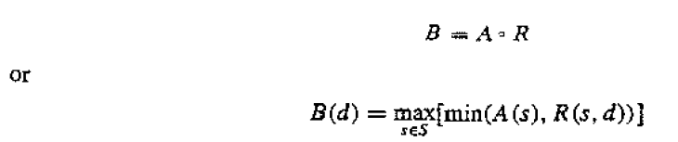
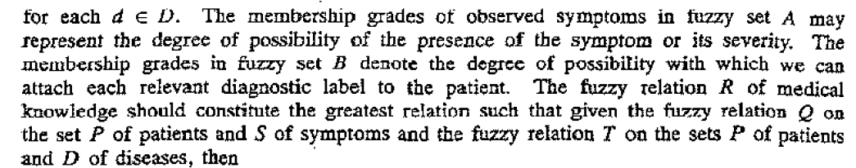

Introduction (cond…)

Slide 114
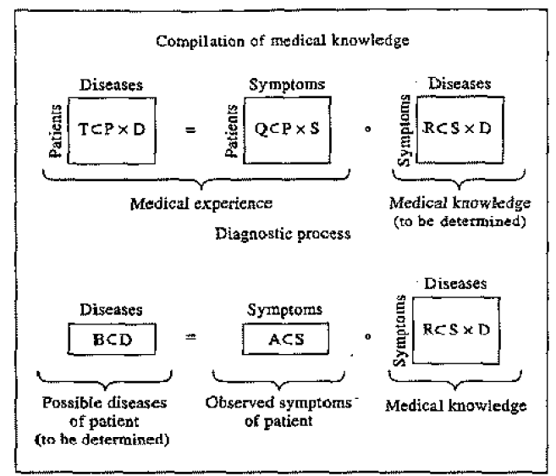
Fuzzy sets and fuzzy relations involved in medical diagnosis

